Slide 1
NATURAL GAS IN A LOW-CARBON ENERGY WORLD
METHANE EMISSIONS

Slide 2
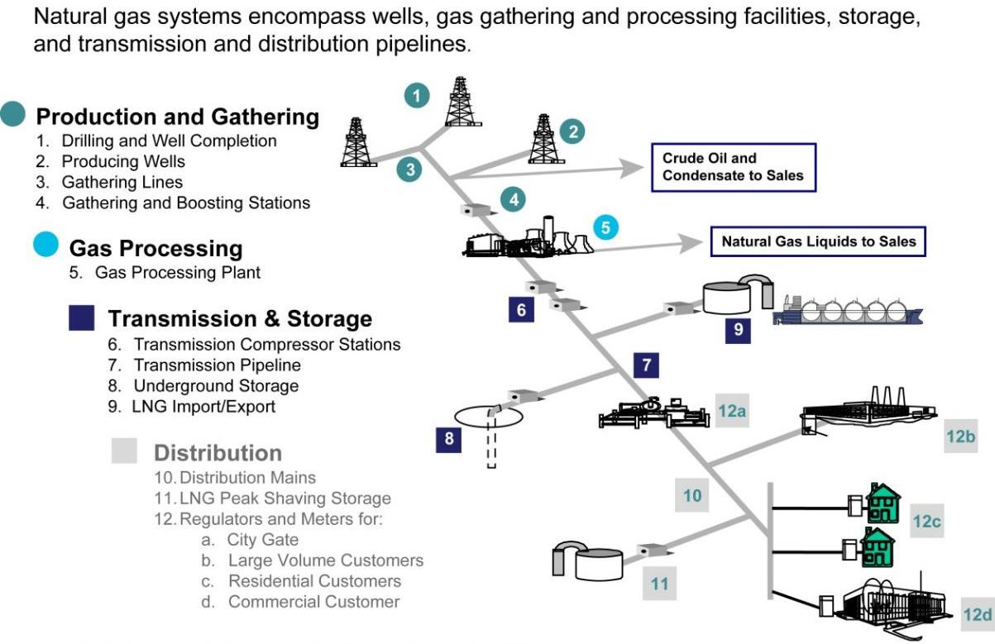
NATURAL GAS SUPPLY CHAIN
Source: Adapted from American Gas Association and EPA Natural Gas STAR Program

Slide 3
METHANE EMISSIONS PROFILE
Millions of Potential “Affected Sources”
1.3 million oil and gas wells
5,000+ gathering/boosting facilities
668 processing facilities
Over 1,800 transmission facilities
Over 400 storage
111 LNG facilities
Regional Variations
Significant regional variations among emission sources
Differences likely attributable to:
Type of natural gas production (i.e. wet gas-vs-dry gas)
Age, number, and type of infrastructure
Super Emitter Phenomenon
Small number of sources are responsible for a disproportionately large number of emissions
Cost-Effective Reduction Opportunities
There are a number of cost-effective emission control technologies that can be employed today
Advancements in emissions monitoring technologies are needed

Slide 4
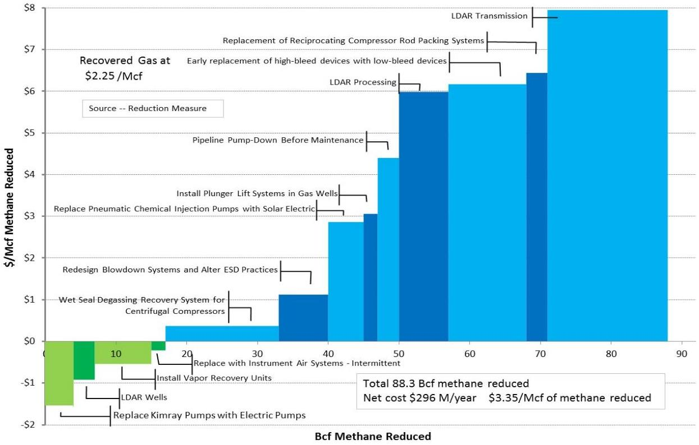
EMISSION REDUCTION OPPORTUNITIES By Emission Source

Slide 5
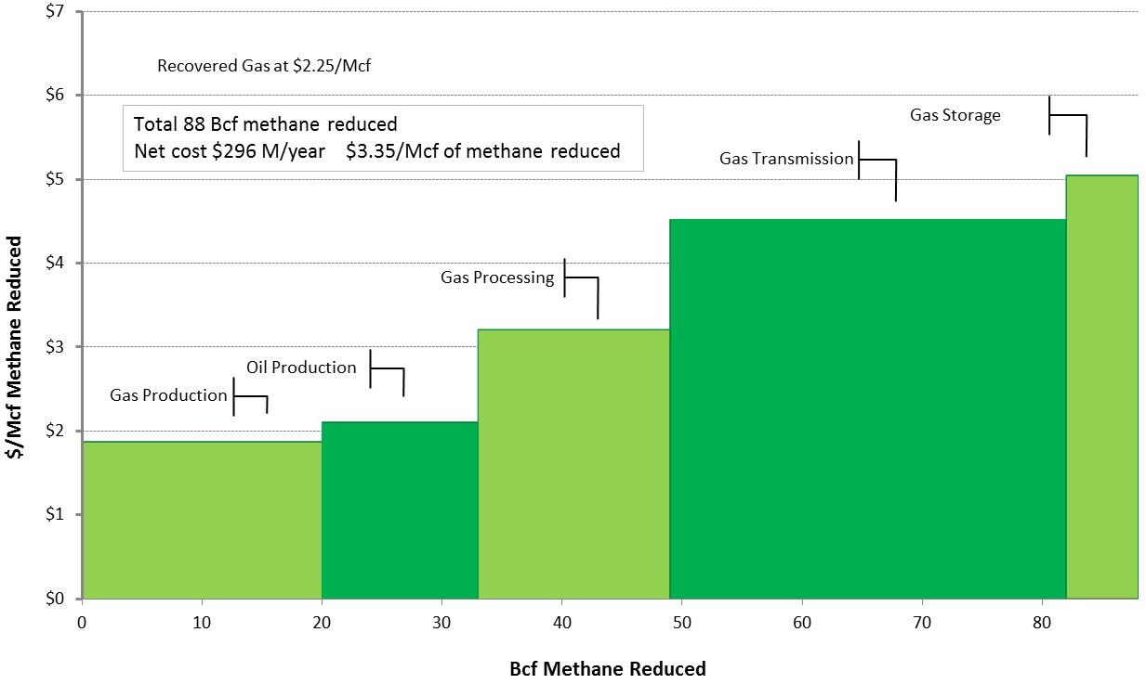
EMISSION REDUCTION OPPORTUNITIES By Industry Segment

Slide 6
POLICY OPTIONS FOR ADDRESSING METHANE EMISSIONS
TECHNOLOGY-BASED DESIGN
Pre-defined emission control technologies are applied to all “affected sources”
Application of control technology is required regardless of the actual emission profile of the source
Technology-based design is more appropriate for a smaller population of homogenous emission sources
Monitoring, recordkeeping and reporting requirements are burdensome due to large number of emission sources
PERFORMANCE-BASED DESIGN
Performance-based design allows companies to focus on “super emitter/fat-tail” emission sources
Each company optimizes emission reductions by focusing capital deployment on its highest emitting sources
Technology-neutral approach encourages development of new technologies to achieve emission reduction goals
Intensity-based metrics enable bench-marking between companies, regardless of size

Slide 7
KEY POLICY DESIGN QUESTIONS
Does the policy match the science of methane emissions?
Does the policy optimize emission reductions by deploying capital on the highest emitting sources?
Does the policy encourage development of new emission reduction technologies?
Does the policy encourage development of new emission detection technologies?
Does the policy provide “reasonable assurance of compliance”?
Can the policy be “enforced in a reasonable manner”?

